Slide 1

Pet Grooming salon & hostel system
PG Diploma in Advanced Computing
Infoway Technologies, Pune

Slide 2
Introduction
providing online platform for Pet Groomers & Pet Hostel owners
Owners can register themselves and will get notifications of their work.
client needs to simply register to website and can book pet groomer & book certified pet hostels online.

Slide 3
Modules
Admin Management
Client management
Product management
Pet Groomers
Pet Hostel Owners

Slide 4
Technology
Frontend :- React-JS
Backend :- Spring Boot
Database :- MySQL (5.7 with workbench 8.0)

Slide 5
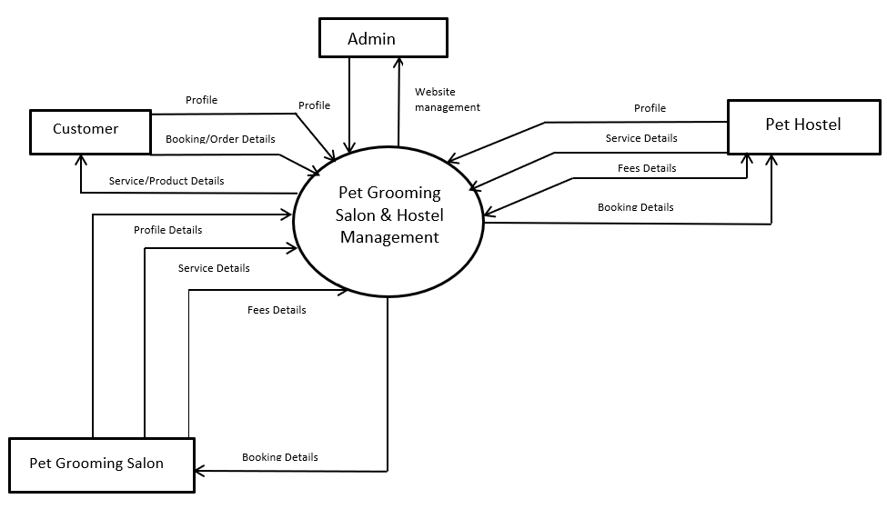
diagram

Slide 6
Future scope
As we are developing a website which offers online booking of pet groomers, online buying of pet food and certified pet hostels, but due to time constraint we are not providing any online payment options/Getways to clients. Therefore as future scope of project one can provide online payment getways. So user/client can make payments online.

